Slide 1

The Big Move
Working out where to live in Toronto

Slide 2
I’m considering moving from Melbourne to Toronto for work.
🇦🇺 🇨🇦
I need to find areas of Toronto to live in.
Preferably, I’d like somewhere similar to where I live now, North Melbourne, a suburb famous for its cafes and hip culture.
Intro

Slide 3
NORTH MELBOURNE

Slide 4
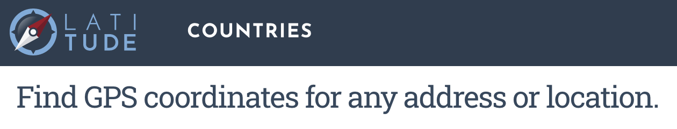
Wikipedia – Toronto neighbourhood data (postal code, borough)
Data
Foursquare API – venues data (location, category)
Latitude.to – geographical coordinates data

Slide 5
1520 venue records
1507 venues within 500m of 32 Toronto neighbourhoods (neighbourhoods within 7.2km of city centre)
13 venues within 500m of North Melbourne
Grouped by category & neighbourhood
K-means cluster analysis
1-10 clusters
10 initialisations per analysis
Elbow point determined for optimal cluster #
Methods

Slide 6
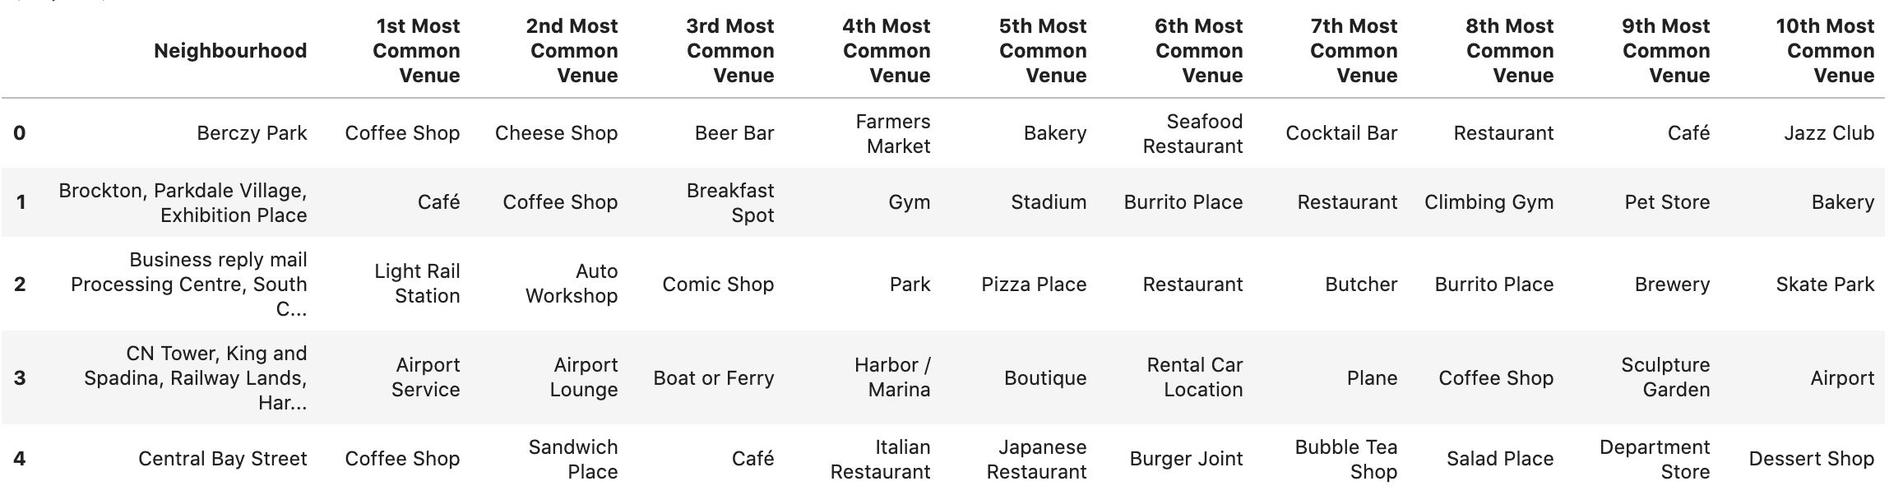
Exploring the data
Results

Slide 7
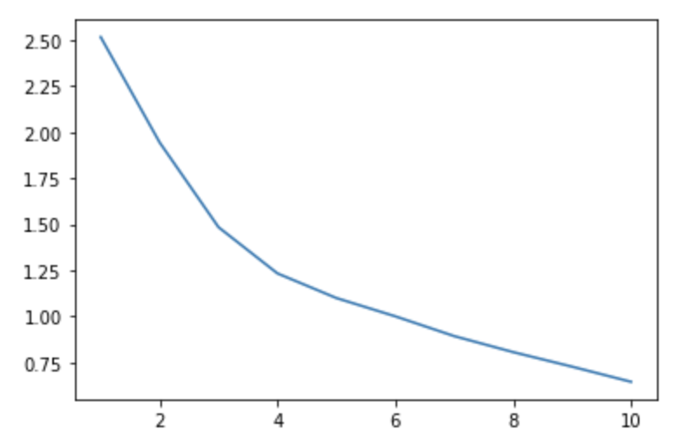
K-means cluster analysis
Results
Elbow point

Slide 8
K-means cluster analysis
Cluster | Number of neighbourhoods
0 | 2
1* | 28
2 | 1
3 | 1
Results
* Containing North Melbourne (not included in count)

Slide 9
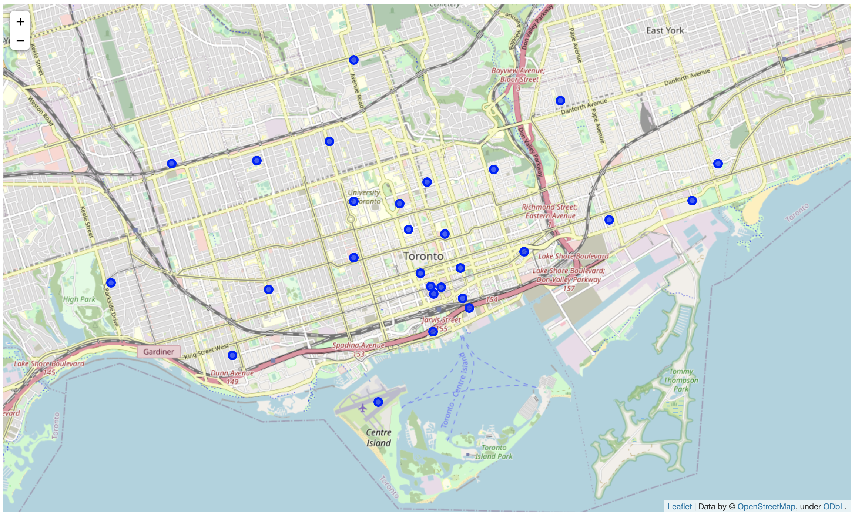
K-means cluster analysis
Results

Slide 10
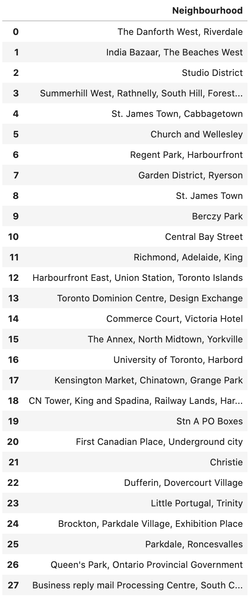
The 28 similar neighbourhoods
Findings

Slide 11
I identified 28 similar neighbourhoods by venue categories & proximity to the city centre.
These may be neighbourhoods that are similar to North Melbourne to consider living in.
Further analysis should be performed including other parameters of importance to neighbourhood similarity.
Conclusion

